Slide 1
SignalGuru: Leveraging Mobile Phones for Collaborative Traffic Signal Schedule Advisory
Emmanouil Koukoumidis (Princeton, MIT)
Li-Shiuan Peh (MIT)
Margaret Martonosi (Princeton)
MobiSys, June 29th 2011

Slide 2
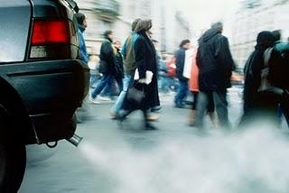
Vehicles: The polluting energy hogs
Cars are big polluters & energy hogs
Produce 32% of total C0₂.
Consume 28% of USA’s total energy.
10 times the energy for computing infrastructure.
* Source: US Environmental Protection Agency (http://www.epa.gov/)

Slide 3
Traffic Signals - GLOSA
Traffic signals:
(+) Provide safety.
(.-.) Enforce a stop-and-go movement pattern.
Increases fuel consumption by 17%*.
Increases CO₂ emissions by 15%*.
Solution: Green Light Optimal Speed Advisory (GLOSA).
* Source: Audi Travolution Project
w/o
GLOSA:
Need to know the schedule of traffic signals.
with
GLOSA:

Slide 4
Signal Schedule Advisory Systems
 | Infrastructure Cost | Predictability | Continuous Advisory | Advance Advisory
Pedestrian countdown timers
Vehicular countdown timers
Road-side speed message signs
Audi Travolution
SignalGuru
$
$$
$$$
None

Slide 5
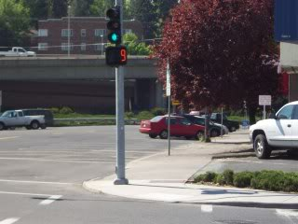

Slide 6
Signal Schedule Advisory Systems
 | Infrastructure Cost | Predictability | Continuous Advisory | Advance Advisory
Pedestrian countdown timers
Vehicular countdown timers
Road-side speed message signs
Audi Travolution
SignalGuru
$
$
$$
$$$
None

Slide 7
Signal Schedule Advisory Systems
 | Infrastructure Cost | Predictability | Continuous Advisory | Advance Advisory
Pedestrian countdown timers
Vehicular countdown timers
Road-side speed message signs
Audi Travolution
SignalGuru
$
$$
$$$
None

Slide 8
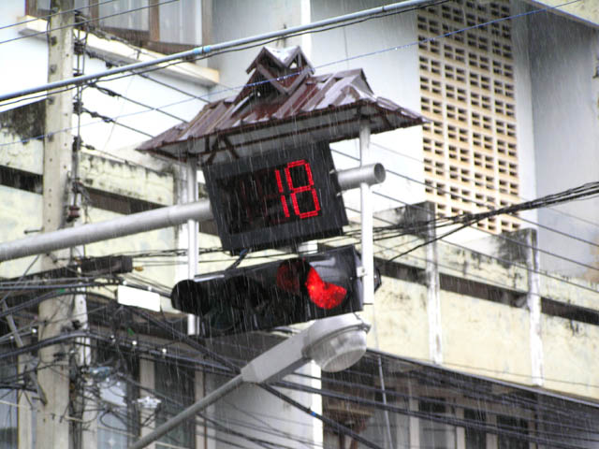
Thailand

Slide 9
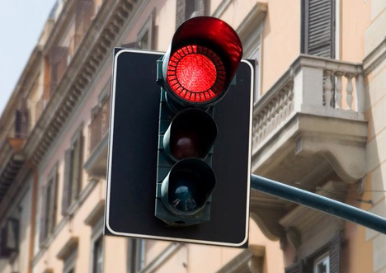
Design: Damjan Stankovich

Slide 10
Design: Thanva Tivawong

Slide 11
Signal Schedule Advisory Systems
 | Infrastructure Cost | Predictability | Continuous Advisory | Advance Advisory
Pedestrian countdown timers
Vehicular countdown timers
Road-side speed message signs
Audi Travolution
SignalGuru
$
$
$$
$$$
None

Slide 12
Signal Schedule Advisory Systems
 | Infrastructure Cost | Predictability | Continuous Advisory | Advance Advisory
Pedestrian countdown timers
Vehicular countdown timers
Road-side speed message signs
Audi Travolution
SignalGuru
$
$
$$
$$$
None

Slide 13
Signal Schedule Advisory Systems
 | Infrastructure Cost | Predictability | Continuous Advisory | Advance Advisory
Pedestrian countdown timers
Vehicular countdown timers
Road-side speed message signs
Audi Travolution
SignalGuru
$
$
$$
None

Slide 14
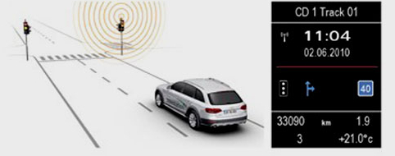
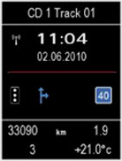
Audi Travolution

Slide 15
Signal Schedule Advisory Systems
 | Infrastructure Cost | Predictability | Continuous Advisory | Advance Advisory
Pedestrian countdown timers
Vehicular countdown timers
Road-side speed message signs
Audi Travolution
SignalGuru
$
$
$$
$$$
None

Slide 16
Signal Schedule Advisory Systems
 | Infrastructure Cost | Predictability | Continuous Advisory | Advance Advisory
Pedestrian countdown timers
Vehicular countdown timers
Road-side speed message signs
Audi Travolution
SignalGuru
$
$
$$
$$$
None

Slide 17
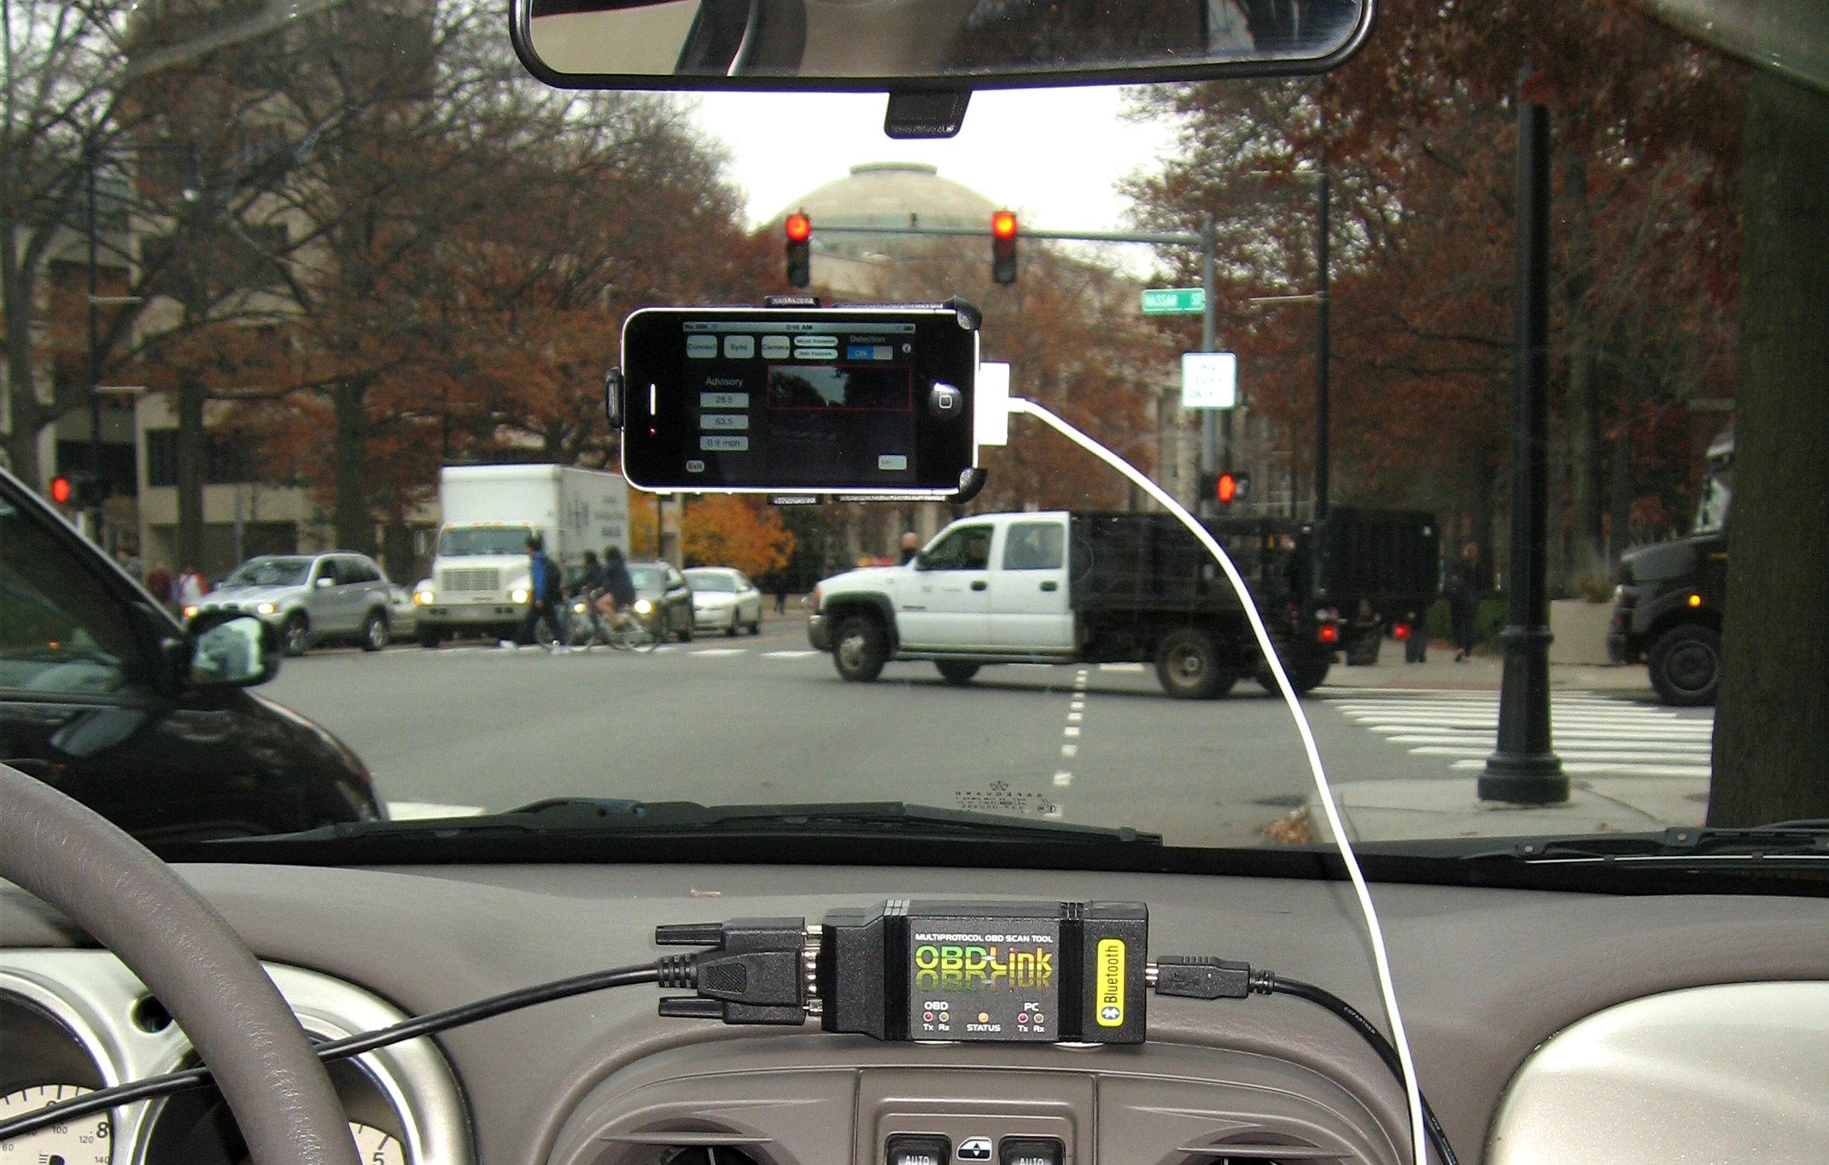
SignalGuru Approach

Slide 18
Challenges
Commodity cameras. Low video resolution:
iPhone 4: 1280 × 720 pixels.
iPhone 3GS: 640 × 480 pixels
Limited processing power.
But need high video processing frequency.
Uncontrolled environment.
Traffic-adaptive traffic signals.
Non-challenge: Energy.

Slide 19
Detection Module
Detects signal current status (Red/Yellow/Green) from video.
New frame every 2sec.
Main features:
Bright color.
Shape (e.g., round, arrow).
Within black housing.
Location in frame (detection window).

Slide 20
IMU-based Detection Window
φ: field of view
ω: roll angle
θ: detection angle
Roll angle ω is calculated by gyro and accelerometer data.
Process only area within detection window.
Cuts off half of the image:
Processing time reduced by 41%.
Misdetection rate reduced by 49%.

Slide 22
Transition Filtering Module
Filters out false positives.
Low Pass Filter:
…→R→R→R→G→R→R→…
Colocation filter.
Red and Green bulbs should be colocated.
frame i
frame i+1
Filters compensates for lightweight but noisy detection module.

Slide 23
Collaboration Module
No cloud server.
Real-time adhoc exchange of timestamped R→G transitions (last 5 cycles) database.
Collaboration:
Improves mutual information.
Enables advance advisory.

Slide 24
Prediction Module
Add to timestamp of phase A’s detected R→G transition (t_{A, R→G}) the predicted Phase Length of A (PL_{A}) to predict R→G transition for B (t_{B, R→G}).
B
A
B
A
PL_{A}
t_{A, R→G}
t_{B, R→G}
Phase Length prediction:
Pre-timed signals: Look-up in database.
Traffic-adaptive traffic signals: Predict based on history of settings using machine learning (SVR).
A
B
Notes:
.

Slide 25
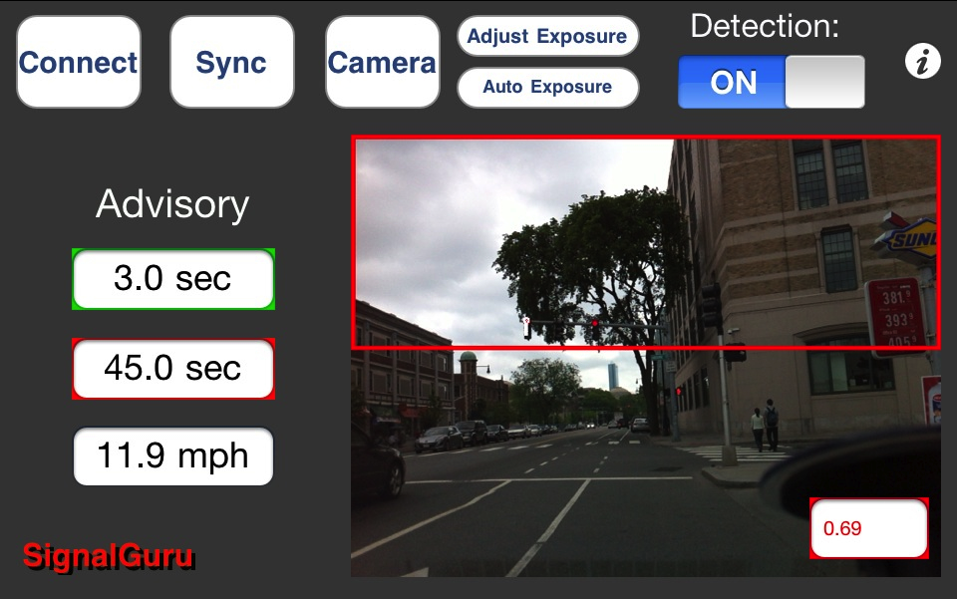
SignalGuru/GLOSA iPhone Application
Residual amount of time in sec until the traffic signal turns green.
Residual amount of time in sec until the traffic signal turns red again.
Recommended GLOSA speed.

Slide 26
SignalGuru Evaluation

Slide 27
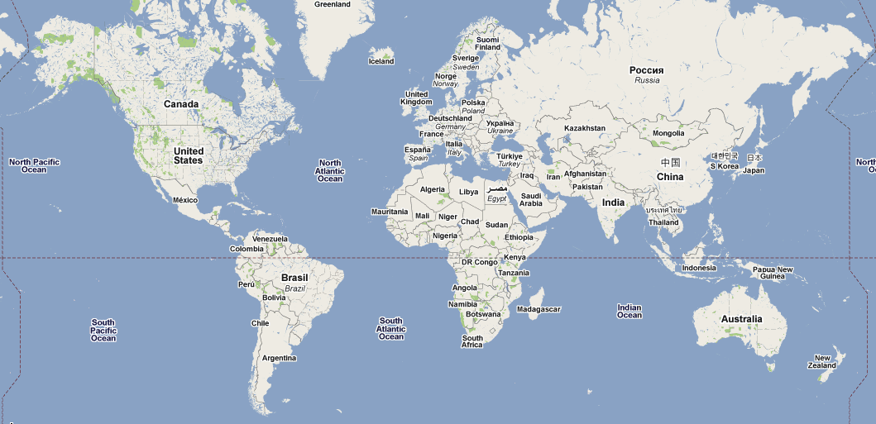
SignalGuru Evaluation
Cambridge (MA, USA)
Singapore

Slide 28
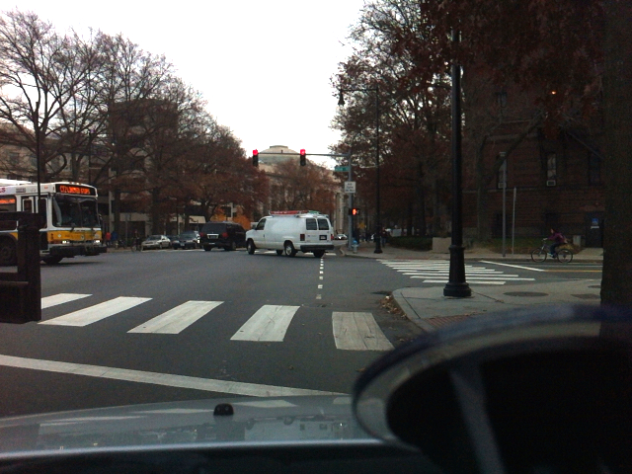
Cambridge: Prediction Accuracy Evaluation
Cambridge (MA, USA)
Pre-timed traffic signals.
Experiment:
5 cars over 3 hours.
3 signals, >200 transitions.
Error_{Average} = 0.66sec (2%).

Slide 29
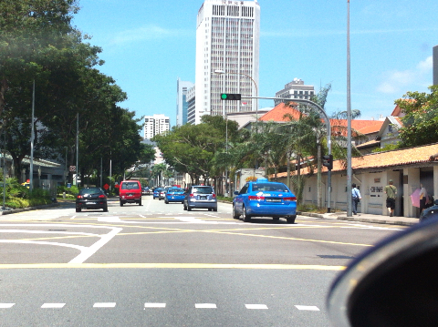
Singapore: Prediction Accuracy Evaluation
Singapore
SignalGuru accurately predicts both pre-timed and traffic adaptive traffic signals.
Traffic-adaptive traffic signals.
Experiment in downtown:
8 cars over 30 min.
2 signals, 26 transitions.
Error_{Average} = 2.45sec (3.8%).
Error_{Transition Detection} = 0.60sec (0.9%).
Error_{Phase Length Prediction} = 1.85sec (2.9%).

Slide 30
Evaluation: GLOSA Fuel Savings
Trip: P₁ to P₂ through 3 signalized intersections.
20 trips to measure fuel consumption.

Slide 31
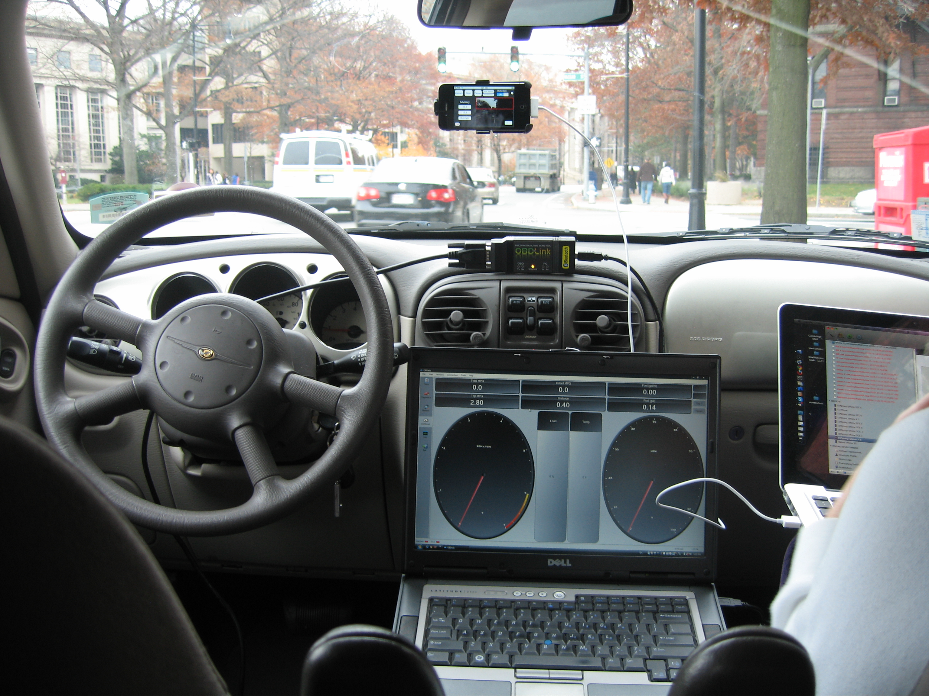
2.4L Chrysler
PT Cruiser ’01
SignalGuru/GLOSA-enabled iPhone
Scan Tool
OBD-LINK device
20%
OBDWiz software (IMAP)

Slide 32
Evaluation: GLOSA Fuel Savings
20%
Without GLOSA driver made on average 1.7/3 stops.
Average fuel consumption reduced by 20.3%.

Slide 33
Conclusions
With selective accelerometer- and gyro-based image detection and filtering near real-time and accurate image processing can be supported.
SignalGuru predicts accurately both pre-timed and traffic-adaptive traffic signals.
SignalGuru-based GLOSA helps save 20% on gas.

Slide 34
Thank you!
Questions?
Emmanouil Koukoumidis
www.princeton.edu/~ekoukoum
Sponsors:

